Slide 1
Project 4
CS2365 Team 4 Presentation

Slide 2
Team List and Video Presentation
Team Members:
Sadman Ahmed Shanto
Cierra Ditmore
Jonathan Gressick
Garrett Olsen
Meghan Engert
Video Presentation Link

Slide 3
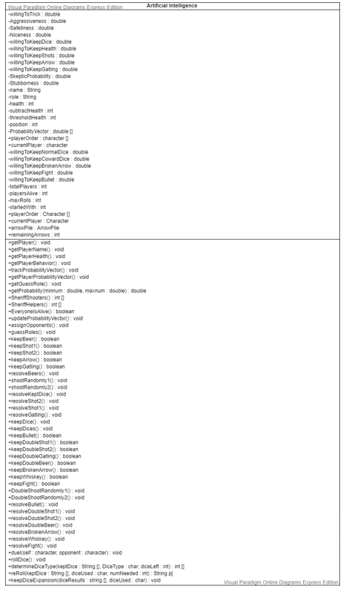
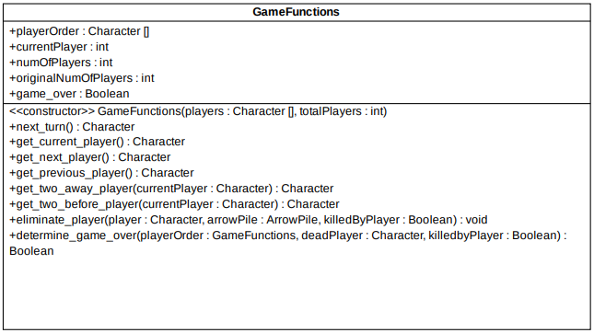
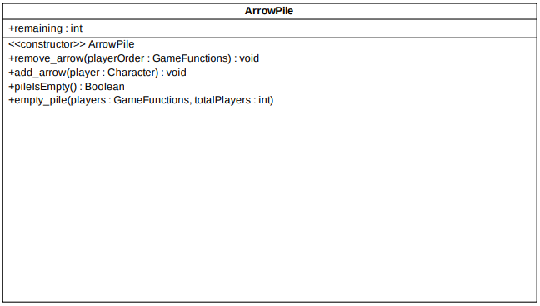
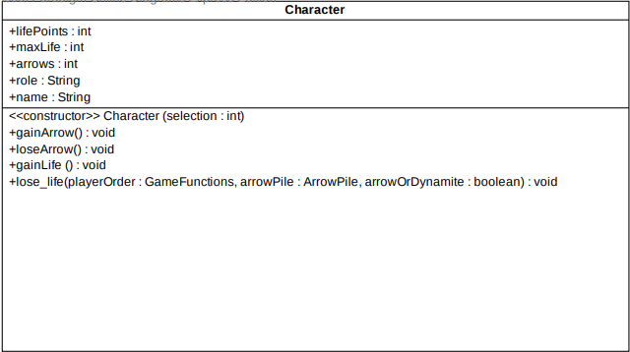
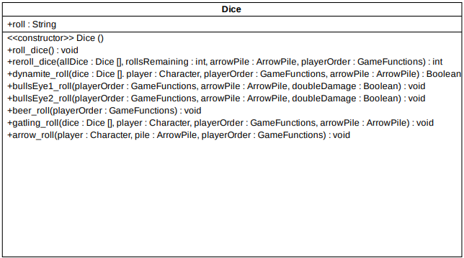
UML Class Diagrams
Artificial Intelligence UML Class Diagram
GameFunctions and Characer UML Class Diagrams
ArrowPile and Dice UML Class Diagrams

Slide 4
Classes Developed
Game Functions Class
Cierra Ditmore
Collaborators:
Dice Class
Cierra Ditmore
Sadman Ahmed Shanto
Arrow Pile Class
Cierra Dimotre
Character Class
Cierra Ditmore
Collaborators:
Artificial Intelligence Class
Sadman Ahmed Shanto
Collaborators:
GUI Class
Garrett Olsen
Jonathan Gressick
Simulate AI Class
Sadman Ahmed Shanto
Collaborators:
AI Dice Class
Sadman Ahmed Shanto
Collaborators

Slide 5
MVC Report: Model
The Bang Dice Game implemented in Java works correctly with minor bugs in the code.
Insert Screen Shot
Problems:
Problem
Problem
Problem

Slide 6
MVC Report: View
The Graphic User Interface is in working condition and will be discussed in depth later on in the presentation.
Include brief screenshot

Slide 7
MVC Report: Controller
The project is completely integrated with all classes working together so the user can:
play the game by giving input to the computer,
play with 3 to 7 Artificial Intelligence players,
And play the game using a Graphic User Interface (GUI).
Include something else here?

Slide 8
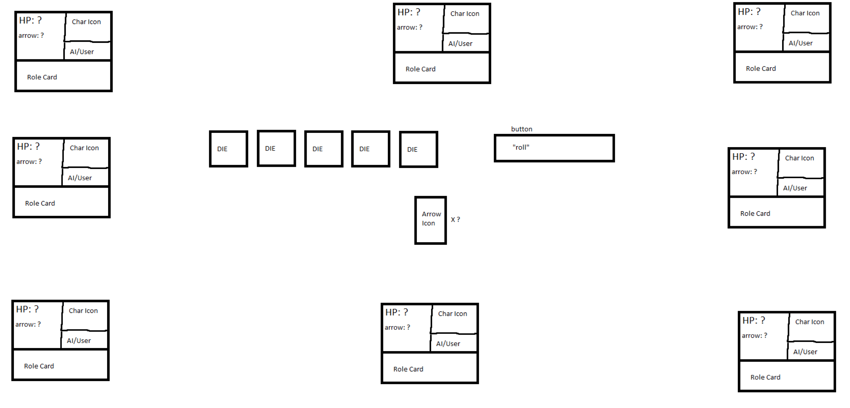
Graphic User Interface (GUI)
GUI Drawing (Draft)
This figure depicts the drawing of the GUI before implementation.

Slide 9
GUI Continued
Brief Description

Slide 10
GUI Continued
Brief Description

Slide 11
GUI Continued
Brief Description

Slide 12
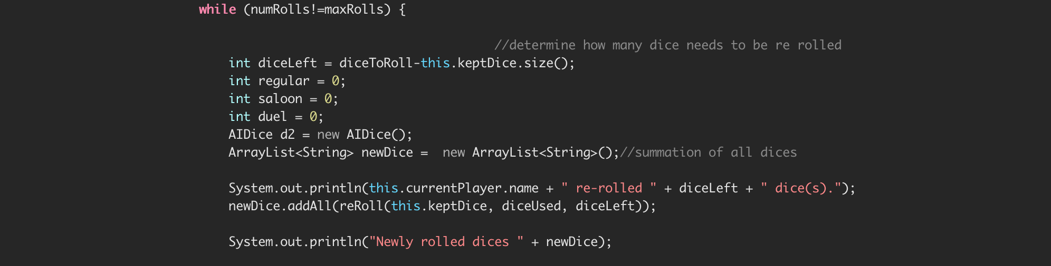
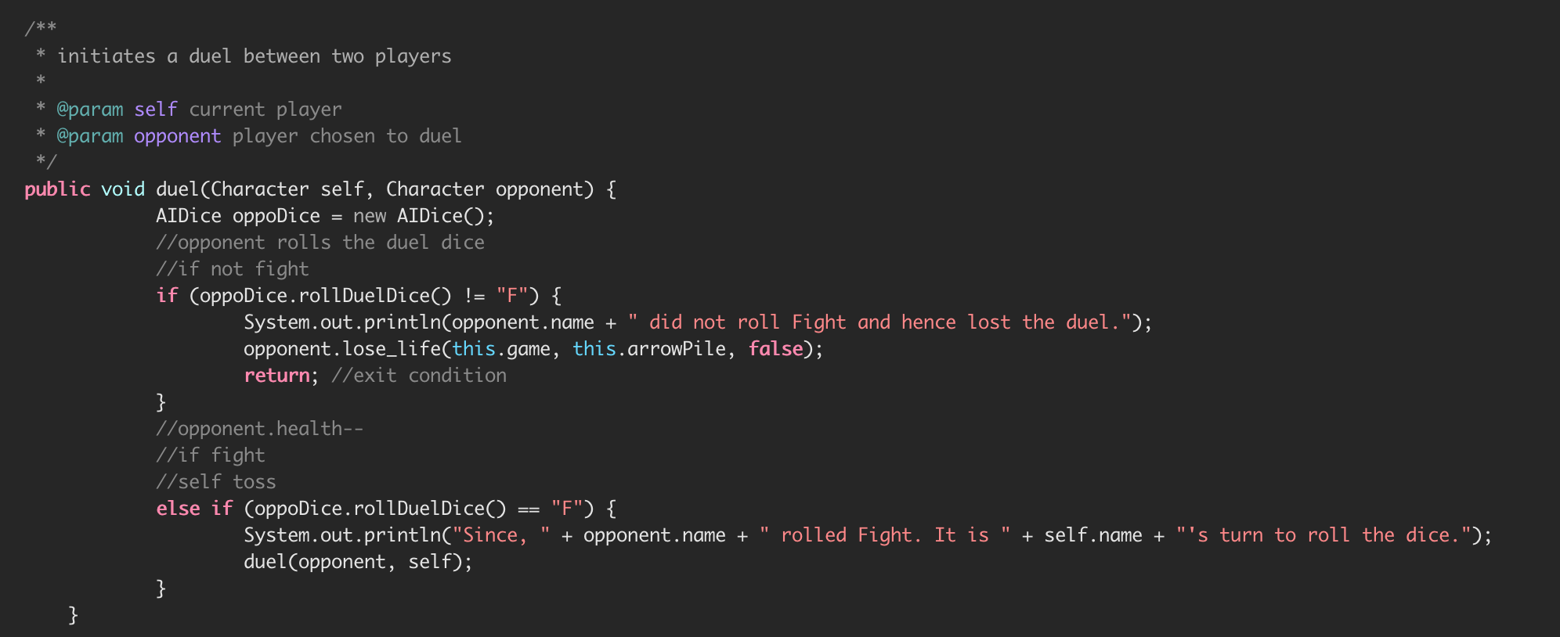
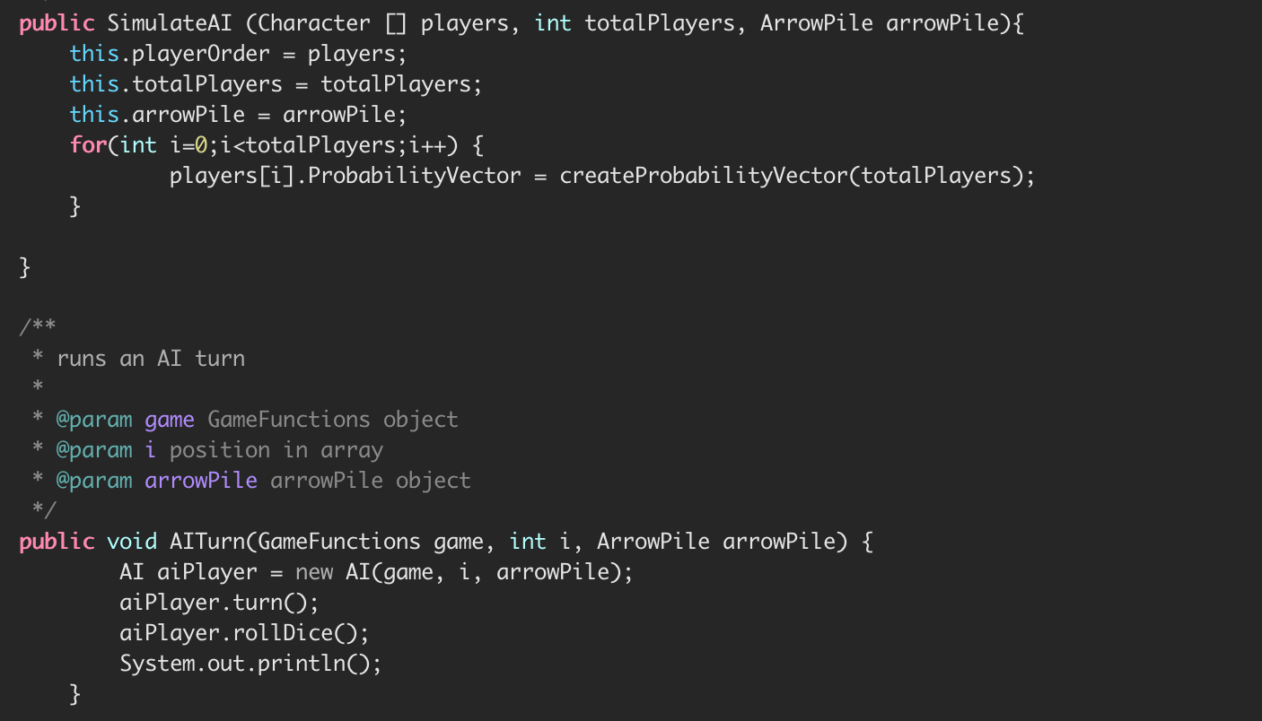
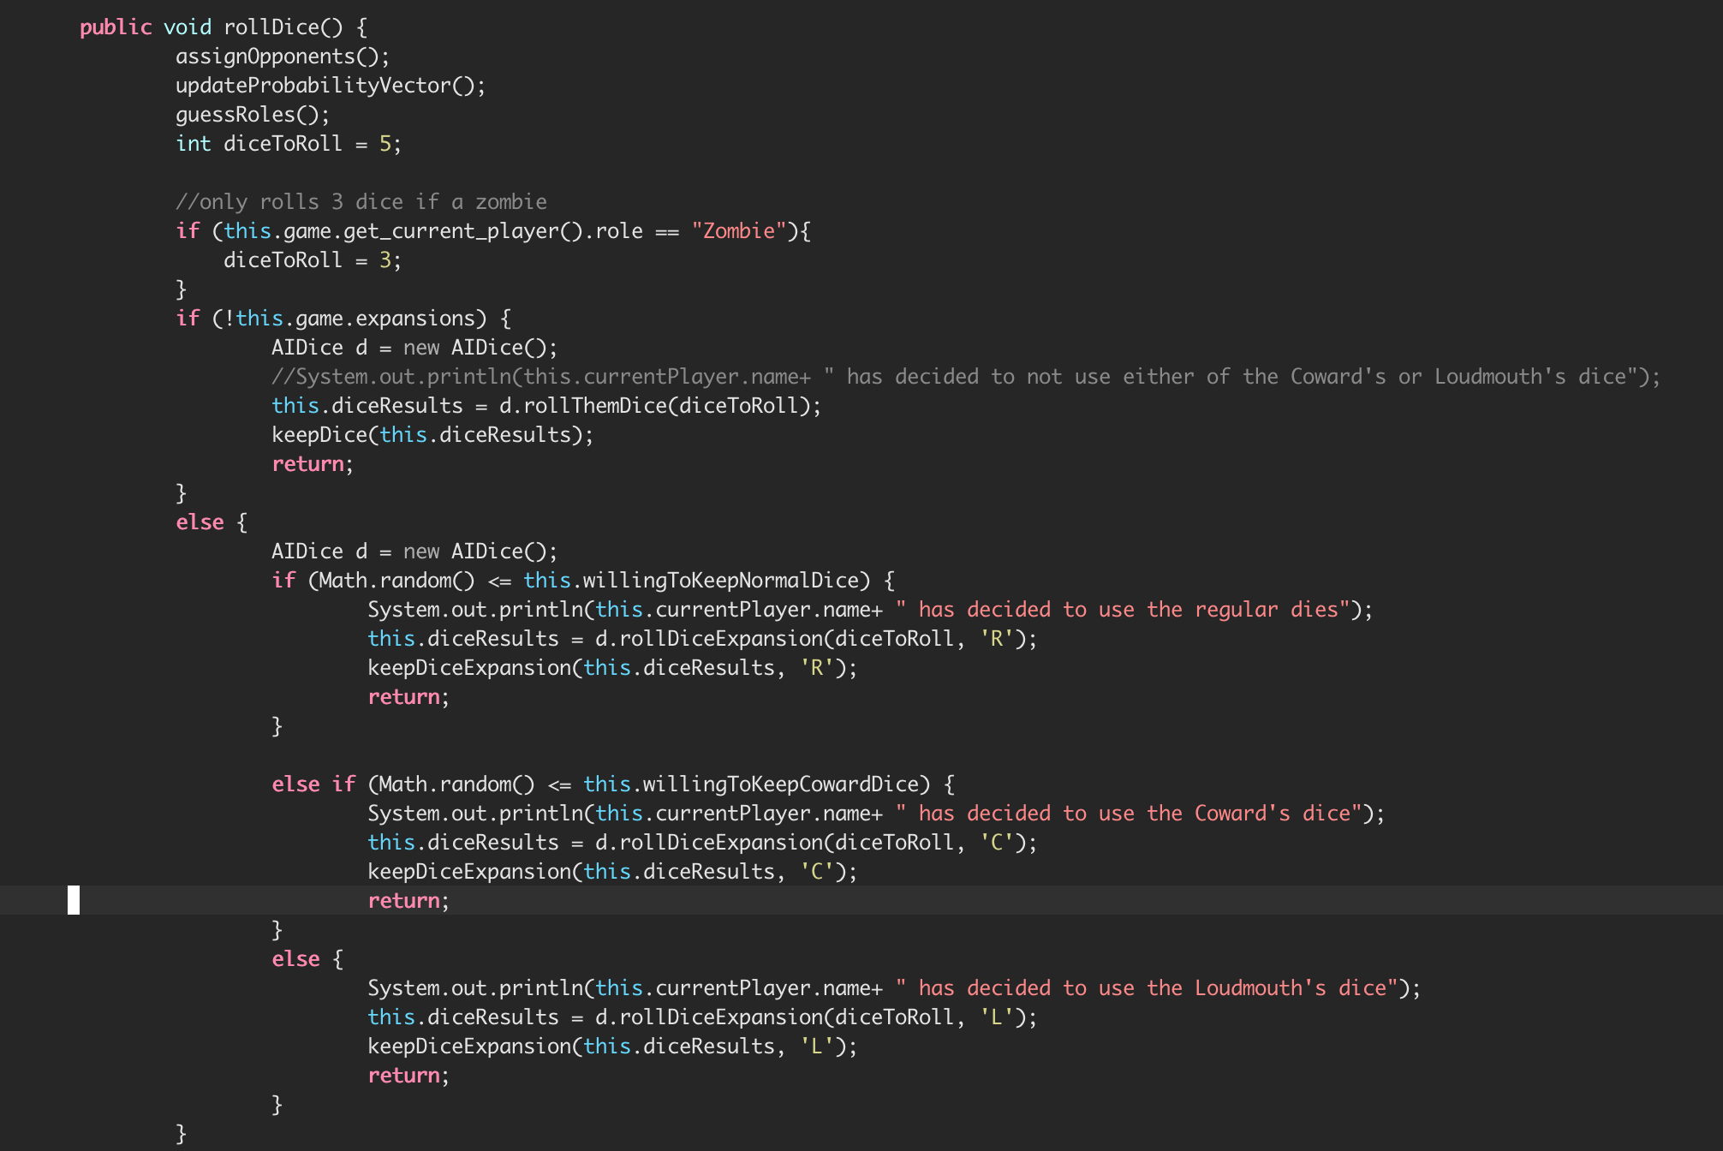
Code Highlights
The AI Dice Class
The AI Class could not exist without the SimulateAI Class (composition).
The AI Dice Class is dependent upon the AI class, thus the class also depends on the Simulate AI class.
Simulate AI Class

Slide 13
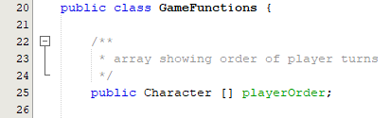
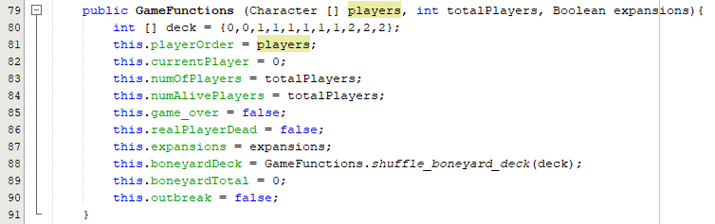
Code Highlights
GameFunctions Class using Character Class Code Fragment
The GameFunctions class makes an array of Character class objects (composition).

Slide 14
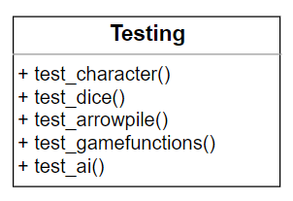
Code Highlights
The Unit Testing for the Character, Dice, ArrowPile, GameFunctions, and AI classes was completed by Cierra Ditmore.
Unit Testing UML Class Diagram

Slide 15
Code Highlights
The Dice Class
Method overloading and overriding was used in the Dice class.

Slide 16
Project Demo
Add link here.

Slide 17
Submission Files
UML Class Diagrams, UML Use-Case Diagrams?
JavaDoc
Source code
Powerpoint

